Slide 1



Title and Team Details
Canopy Sentinel – Krishi Sahay
AI-Powered Agricultural Land Intelligence
Team Name: Vyomveda
Team Leader Name: Vayu Nandan Tripathi
Institute Name: Galgotias University
Members name : Abhinay Singh
Harsh Raj

Slide 2
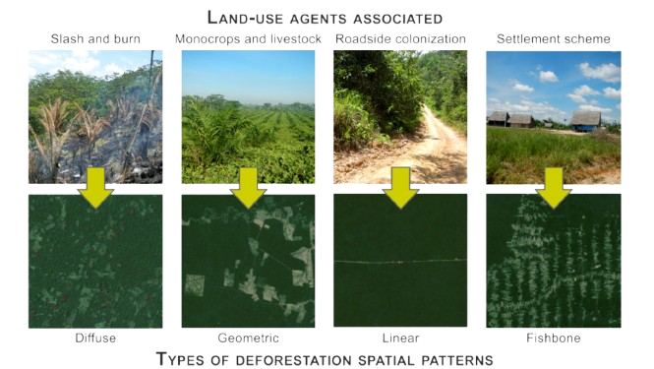
Problem and Solution
Problem
Farmers often acquire agricultural land and plan crops without access to accurate, real-time information about soil fertility, water availability, climate conditions, and surrounding land productivity. Traditional soil testing is time-consuming, expensive, and limited in coverage, while satellite and environmental data remain inaccessible to rural communities due to complex platforms and lack of user-friendly tools.
Solution
We propose a smart Android application built using Kotlin that integrates NASA satellite data and geospatial maps to help farmers analyze agricultural land scientifically.
Uses satellite imagery and geospatial APIs to monitor forest cover changes.
Detects deforestation zones using vegetation analysis (NDVI) and spatial data.
Provides interactive maps, heatmaps, alerts, and analytics through a user-friendly interface.
Enables early awareness, faster intervention, and data-driven conservation decisions.

Slide 3
Methodology & Implementation
The Canopy Sentinel application follows a modular and data-driven approach to across devices. enable real-time deforestation monitoring and accurate visualization.
The frontend is developed using Java in Android Studio, following Material Design principles to ensure smooth navigation, responsive layouts, and a user-friendly experience
The backend integrates Google Geo Tools API to fetch real-time satellite imagery, vegetation indices (NDVI), and deforestation indicators from global data sources.
Data is retrieved using REST APIs and processed in lightweight JSON format, enabling efficient communication and low latency.
A structured data-processing pipeline filters and parses satellite responses to extract location-specific deforestation metrics, even under limited connectivity.
A custom dashboard visualizes insights through interactive maps, heatmaps, acres of forest loss, and zone-wise analytics, updating dynamically based on user-selected regions.
This approach ensures high performance, real-time insights, and accessibility for researchers, NGOs, and authorities.

Slide 4
Technology Used
Core Processing
JavaCV (OpenCV): Image processing and computer vision for deforestation detection
GeoTools: Geospatial data handling and spatial analysis
Machine Learning: TensorFlow / Deep Learning
Desktop Application
JavaFX: Desktop user interface development
PostgreSQL + PostGIS: Local geospatial data storage and spatial querying
Additional Tools & Libraries
Hibernate / JPA: ORM and database mapping
Leaflet.js / OpenLayers: Web-based map visualization
Maven / Gradle: Java build and dependency management
Docker: Containerized deployment (optional)
Cloud: AWS / Azure / GCP (for scalable deployments)
Web Application
Backend: Spring Boot (Java)
Frontend: React (JavaScript)
Database: PostgreSQL + PostGIS (spatial database extension)
APIs: NASA Earthdata, Google Earth Engine for satellite imagery

Slide 5
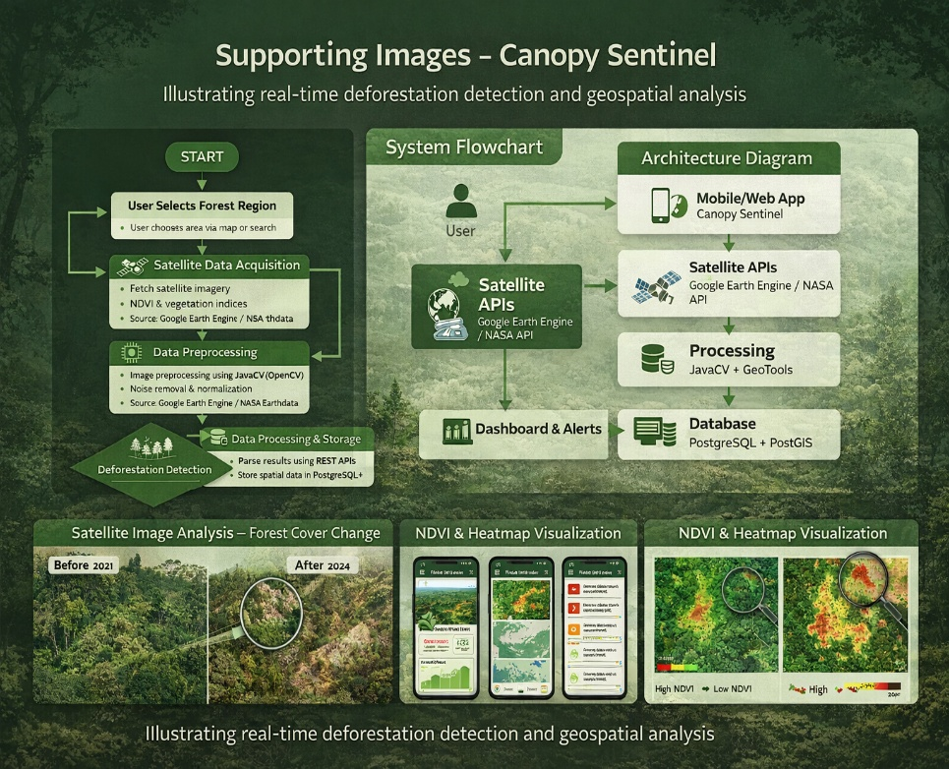
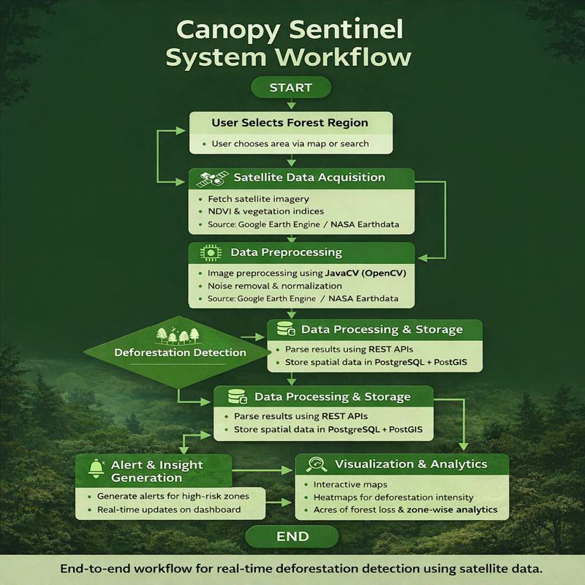
Flowchart & Supporting Images

Slide 6
Feasibility and Market Use
Feasibility
Built using existing satellite data and open geospatial technologies, making the system cost-effective and scalable.
Modular architecture allows easy integration with mobile, web, and desktop platforms.
Works in real-time with low latency, even in regions with limited infrastructure.
Can be extended with AI/ML models for predictive deforestation analysis in future.
Suitable for deployment at local, national, and global levels.
Market Use
Farmers – Land selection, crop planning, productivity improvement
Agri Companies – Precision farming & analytics
Government Forest Departments:
Real-time monitoring, illegal logging detection, policy support, and resource planning.
NGOs & Environmental Organizations:
Field monitoring, conservation planning, and impact assessment.
Educational Institutions:
Practical learning tool for environmental studies and climate awareness.
Researchers & Analysts:
Long-term forest trend analysis and biodiversity research.
Public & Communities:
Awareness generation through interactive maps and visual insights.

Slide 7
Conclusion
Canopy Sentinel demonstrates how mobile technology combined with real-time satellite data can effectively address the global challenge of deforestation.
The system bridges the gap between complex geospatial data and user-friendly visualization, making forest monitoring accessible to professionals and the general public.
By integrating Google Geo Tools API, satellite imagery, and interactive dashboards, the platform enables near real-time monitoring of forest regions such as the Amazon Basin.
Features like heatmaps, location-based alerts, and interactive maps enhance awareness and support informed decision-making.
The project highlights the feasibility, scalability, and real-world impact of digital solutions in environmental conservation.
Canopy Sentinel reflects the potential of open-source and geospatial technologies in supporting sustainability and climate change mitigation.

